Slide 1
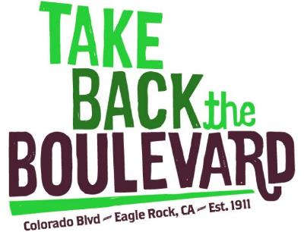
Eagle Rock City Hall
April 19,2017
Phase II Kickoff Meeting

Slide 2
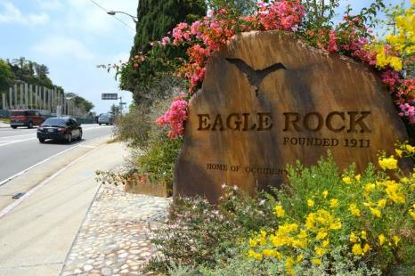
Welcome
Bob Gotham, Chair Take Back the Boulevard
Allen Compton, TBTB Steering Committee
Mark Vallianotos, TBTB Steeering Committee
Nate Hayward, Council District 14 – Public Works Director
Bureau of Street Services Representatives

Slide 3
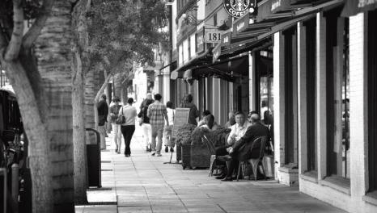
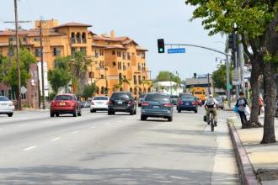
MAJOR
GOALS
Safety
Sustainable
Equitable
Economic Vitality
Small Town Pride

Slide 4
Community Guided Initiative

Slide 5
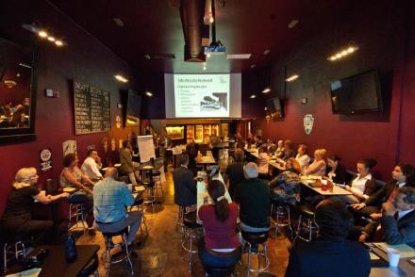
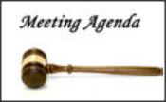
History
Phase II Introduction
Conceptual Plans
Next Steps
Coming Soon on a street near you

Slide 6
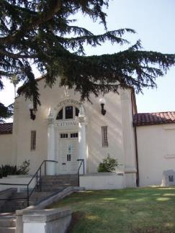
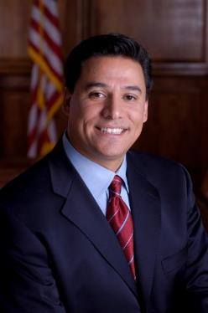
How Did We Get Here?
Strong Support
from
Councilmember
Jose Huizar

Slide 7
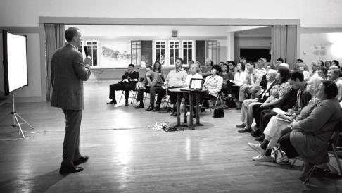
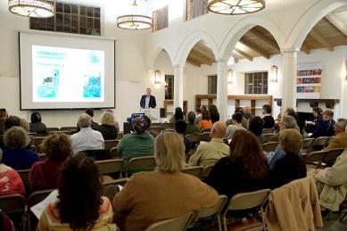
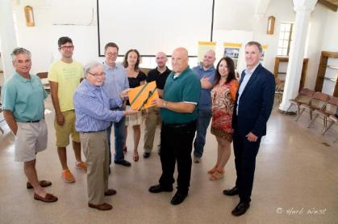
Community Involvement
2011 -2017
14 Community Meetings
60 Steering Committee Meetings
Dedicated Community Leadership
Financial Support – TERA, CD14 & ERNC

Slide 8
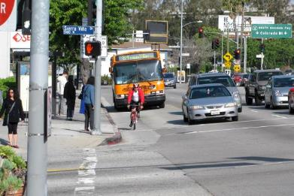
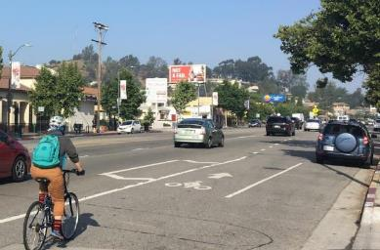
Accomplishments
Safety
Road Diet
Bike Lanes

Slide 9
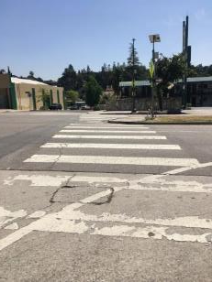
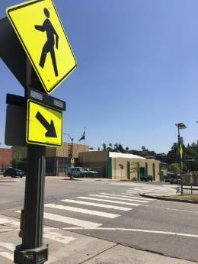
Accomplishments
Safety
Continental Crosswalks
Protected Crosswalks

Slide 10
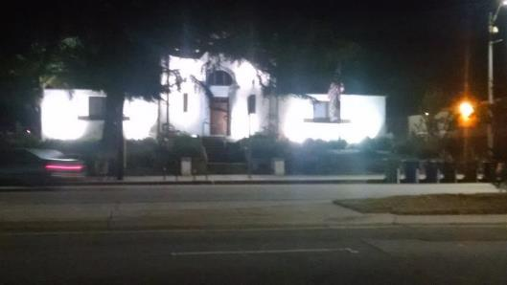
ACCOMPLISHMENT City Hall – Exterior Lighting
Supports the small town spirit and activates the Boulevard, making it safer.

Slide 11
Accomplishment

Slide 12
More to be done

Slide 13
Eagle Rock
Metro Call for Projects $2.2M
Active Transportation Program $9.7M
Total $11.9M

Slide 14
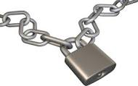
Vision Plan Grant Goals Guidelines
Important Guidelines

Slide 15
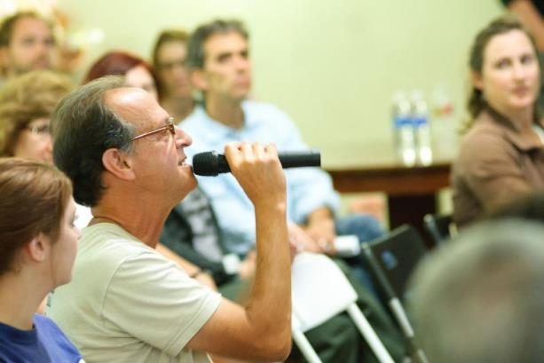
Community has spoken.
Some design alternatives to be resolved.

Slide 16
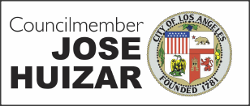
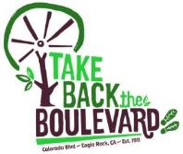
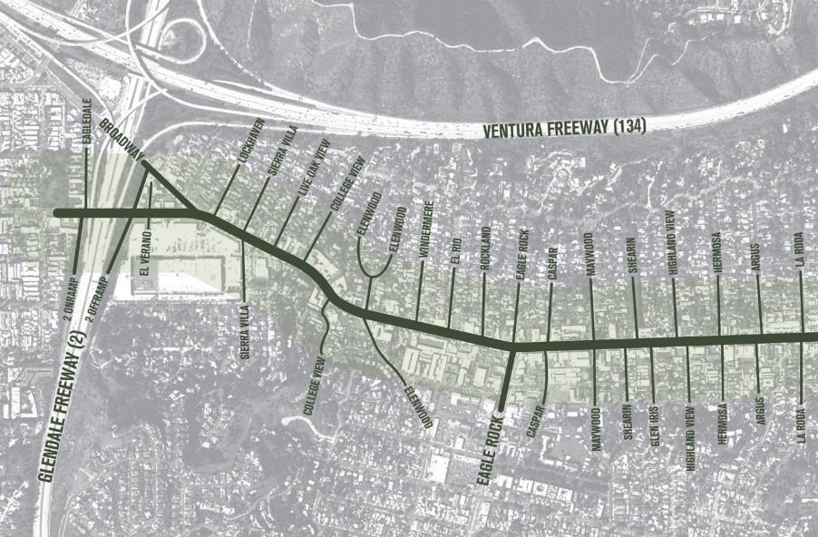
Conceptual Plans

Slide 25
Next Steps
Community Meeting
BSS - Do it
Celebrate

Slide 26
Coming soon, at a street nearby
RTB Steering Committee
Bob Gotham, Chair Brian Bowman
Allen Compton Jane Demian
Kathleen Dunleavy Severin Martinez
Sean Starkey Mark Vallianotos

